Slide 1
The Pochoir Stencil Generator
Yuan Tang, Charles E. Leiserson, Bradley C. Kuszmaul, Chi-Keung Luk, Will Hansplaugh, Rezaul Alam Chowdhury

Slide 2
Background
For a given point, a stencil is a fixed subset of nearby neighbors.
A stencil code updates every point in an n-dimensional spatial grid at time t as a function of nearby grid points at times t–1, t-2, …, t–k.
Stencils are used in iterative PDE solvers such as Jacobi, Multi-grid, and AMR, as well as for image processing and geometric modeling.
x+1
z+1
y+1
y-1
(x,y,z)
z-1
x-1
3D regular grid
3D 7-point stencil
2
Notes:
Stencils are critical to many applications (e.g. diffusion, electromagnetics, image processing)

Slide 3
Looping Implementation
A nested loop implementation is straightforward:
for (t = 1; t≤T, ++t) {
for (i0 = 0, i0<n0, ++i0) {
for (i1 = 0, i1<n1, ++i1) {
for (i2 = 0, i2<n2, ++i2) {
⟨⟨ update A[t%k,i0,i1,i2] according to stencil ⟩⟩
} } } }
Issue: Looping is memory intensive, especially for parallel implementations, and it uses caches poorly.

Slide 4
Cache-Oblivious Algorithms
t
x
Divide-and-conquer cache-oblivious techniques, based on trapazoidal decompositions, are known to be effective.
Problem: These codes are difficult to write.

Slide 5
Pochoir Stencil Generator
The stencil specification separates the stencil mathematics from the algorithm used to divide and conquer the computing domain.
The generated stencil code uses efficient cache-oblivious algorithms based on divide-and-conquer.
The stencil computation is parallelized using the Intel Cilk Plus technology.

Slide 6
Executable Specification
The stencil specification can be executed and tested for correctness without Pochoir using a C++ template library.
The specification supports arbitrary D-dimensional rectangular grids, where D is a compile-time constant.
The stencil shape can be arbitrary.
A point at time t can depend on points at time t–1, t–2, …, t–k, where k is a compile-time constant.
Both periodic and nonperiodic boundary conditions are supported.

Slide 7
2D Heat Equation in Ideal Specification
Pochoir<double, 2> heat;
Pochoir_Array<double, 2> a(N, M);
Pochoir_Shape<2> shape[6] = {{0, 0, 0}, {-1, 1, 0}, {-1, 0, 0}, {-1, -1, 0}, {-1, 0, -1}, {-1, 0, 1}};
Pochoir_Boundary_2D(bdry, arr, t, i, j)
if (i <= 0 || i >= arr.size(1)-1 || j < =0 || j >= arr.size(0)-1)
return 0;
else
return arr.get(t, i, j);
Pochoir_Boundary_end
Pochoir_kernel_2D(kern, t, i, j)
a(t, i, j) = 0.125 * (a(t-1, i+1, j) - 2.0 * a(t-1, i, j) + a(t-1, i-1, j)) + 0.125 * (a(t-1, i, j+1) - 2.0 * a(t-1, i, j) + a(t-1, i, j-1)) + a(t-1, i, j);1)) + a(t-1, i, j);
Pochoir_kernel_end
for (int i = 0; i < N; ++i) {
for (int j = 0; j < N; ++j) {
a(0, i, j) = rand();
}}
heat.registerBoundaryFn(a, bdry);
heat.registerShape(shape);
heat.registerKernel(kern);
heat.run(T);
Define
Initialize
Register
Run
Notes:
We need either registerBondaryFn() (so we can NOT associate boundary function directly in Pochoir_Array’s constructor) or registerArray() because
We need to check the consistency in shape of each engaged Pochoir_Array
We need to extract the computing domain out of this array of Pochoir_Array – because we don’t have registerDomain() now
We need to know all the info about participated Pochoir_Array to optimize the base case
How to deal with function template, which parametrize the types of input Pochoir_Array and Pochoir object. Then we will have no idea of <type, rank, toggle> pair of Pochoir_Array, then we can NOT optimize it by using the pointer/zero-pointer. In this case we will have to switch to macro tricks instead, which also relies on the use of registerBoundaryFn(), registerArray() to know which is engaged. But even macro tricks need to know the rank of engaged Pochoir_Array. So, at least, Pochoir object can NOT be templated. – so the question is, in such situation, shall we print out some error message, and ask the user to change his program, or still compile but without any performance improv
The only thing that can be further compacted is directly associate shape and kernel with Pochoir object. But
First, it puts a strict order between definition of shape, kernel and Pochoir object
It eliminates the flexibility of associate different shape with the same Pochoir object, and re-run it with different kernel
Current Pochoir object is very flexible and can be freely plugged in any stencil computation parameters and run it as long as it’s a 2D stencil.
By using a class, instead of plugging in the necessary parameters of a stencil and run it, it’s the same difference as asking the user to finish the construction of an automobile and/or just asking them to input the routing information and just drive it.

Slide 8
2D Heat Equation in current specification
Pochoir<double, 2> heat;
Pochoir_Array<double, 2> a(N, M);
Pochoir_Shape<2> shape[6] = {{0, 0, 0}, {-1, 1, 0}, {-1, 0, 0}, {-1, -1, 0}, {-1, 0, -1}, {-1, 0, 1}};
Pochoir_Boundary_2D(bdry, arr, t, i, j)
if (i <= 0 || i >= arr.size(1)-1 || j < =0 || j >= arr.size(0)-1)
return 0;
else
return arr.get(t, i, j);
Pochoir_Boundary_end
Pochoir_kernel_2D(kern, t, i, j)
a(t, i, j) = 0.125 * (a(t-1, i+1, j) - 2.0 * a(t-1, i, j) + a(t-1, i-1, j)) + 0.125 * (a(t-1, i, j+1) - 2.0 * a(t-1, i, j) + a(t-1, i, j-1)) + a(t-1, i, j);1)) + a(t-1, i, j);
Pochoir_kernel_end
for (int i = 0; i < N; ++i) {
for (int j = 0; j < N; ++j) {
a(0, i, j) = rand();
}}
heat.registerBoundaryFn(a, bdry);
heat.registerShape(shape);
heat.run(T, kern);
Define
Initialize
Register
Run

Slide 9
Declare a Stencil Computation
Pochoir<double, 2> heat;
Pochoir_Array<double, 2> a(N, M);
Pochoir_Shape<2> shape[6] = {{0, 0, 0}, {-1, 1, 0}, {-1, 0, 0}, {-1, -1, 0}, {-1, 0, -1}, {-1, 0, 1}};
Pochoir_Boundary_2D(bdry, arr, t, i, j)
if (i <= 0 || i >= arr.size(1)-1 || j < =0 || j >= arr.size(0)-1)
return 0;
else
return arr.get(t, i, j);
Pochoir_Boundary_end
Pochoir_kernel_2D(kern, t, i, j)
a(t, i, j) = 0.125 * (a(t-1, i+1, j) - 2.0 * a(t-1, i, j) + a(t-1, i-1, j)) + 0.125 * (a(t-1, i, j+1) - 2.0 * a(t-1, i, j) + a(t-1, i, j-1)) + a(t-1, i, j);1)) + a(t-1, i, j);
Pochoir_kernel_end
for (int i = 0; i < N; ++i) {
for (int j = 0; j < N; ++j) {
a(0, i, j) = rand();
}}
heat.registerBoundaryFn(a, bdry);
heat.registerShape(shape);
heat.run(T, kern);
Pochoir < type, dim, toggle> name;
type is the type of the arrays used by the stencil computation.
dim is the number of spatial dimensions.
toggle is the number of internal toggle array. By default, the value of toggle is 2.
name is the name of the stencil object.
Declare a Pochoir Stencil object heat, which is of type double, rank 2, and default toggle 2

Slide 10
Array Declaration
Pochoir<double, 2> heat;
Pochoir_Array<double, 2> a(N, M);
Pochoir_Shape<2> shape[6] = {{0, 0, 0}, {-1, 1, 0}, {-1, 0, 0}, {-1, -1, 0}, {-1, 0, -1}, {-1, 0, 1}};
Pochoir_Boundary_2D(bdry, arr, t, i, j)
if (i <= 0 || i >= arr.size(1)-1 || j < =0 || j >= arr.size(0)-1)
return 0;
else
return arr.get(t, i, j);
Pochoir_Boundary_end
Pochoir_kernel_2D(kern, t, i, j)
a(t, i, j) = 0.125 * (a(t-1, i+1, j) - 2.0 * a(t-1, i, j) + a(t-1, i-1, j)) + 0.125 * (a(t-1, i, j+1) - 2.0 * a(t-1, i, j) + a(t-1, i, j-1)) + a(t-1, i, j);1)) + a(t-1, i, j);
Pochoir_kernel_end
for (int i = 0; i < N; ++i) {
for (int j = 0; j < N; ++j) {
a(0, i, j) = rand();
}}
heat.registerBoundaryFn(a, bdry);
heat.registerShape(shape);
heat.run(T, kern);
Pochoir_Array< type, dim, toggle> name(size_{dim–1}, …, size₁, size₀);
type is the type of the stencil array
dim is the number of dimensions
toggle is the number of internal toggle array. By default, the value of toggle is 2.
name is the name of array
size_{dim–1}, …, size₁, size₀ , are the sizes of each spatial dimension
Declare a Pochoir_Array object a, which is of type double ,rank 2, and default toggle 2, all the spatial dimensions are N unit long.
Class Pochoir_Array contains both underlying storage and corresponding operating methods.

Slide 11
Stencil Declaration
Pochoir<double, 2> heat;
Pochoir_Array<double, 2> a(N, M);
Pochoir_Shape<2> shape[6] = {{0, 0, 0}, {-1, 1, 0}, {-1, 0, 0}, {-1, -1, 0}, {-1, 0, -1}, {-1, 0, 1}};
Pochoir_Boundary_2D(bdry, arr, t, i, j)
if (i <= 0 || i >= arr.size(1)-1 || j < =0 || j >= arr.size(0)-1)
return 0;
else
return arr.get(t, i, j);
Pochoir_Boundary_end
Pochoir_kernel_2D(kern, t, i, j)
a(t, i, j) = 0.125 * (a(t-1, i+1, j) - 2.0 * a(t-1, i, j) + a(t-1, i-1, j)) + 0.125 * (a(t-1, i, j+1) - 2.0 * a(t-1, i, j) + a(t-1, i, j-1)) + a(t-1, i, j);1)) + a(t-1, i, j);
Pochoir_kernel_end
for (int i = 0; i < N; ++i) {
for (int j = 0; j < N; ++j) {
a(0, i, j) = rand();
}}
heat.registerBoundaryFn(a, bdry);
heat.registerShape(shape);
heat.run(T, kern);
Pochoir_Shape<dim> name[cell_count] = {cells};
dim is the number of dimensions
cell_count is the number of cells specified in cells
cells is a list of the cells in the stencil
Declare the shape of the dim-dimensional stencil as a list of cell_count cells, where each cell specifies the offset of indices in the Pochoir_Array, e.g., for a(t+1, i, j), we specify the corresponding cell {1, 0, 0}, for a(t, i+1, j), we specify {0, 1, 0}, and so on

Slide 12
Declaration of Boundary Function
Pochoir<double, 2> heat;
Pochoir_Array<double, 2> a(N, M);
Pochoir_Shape<2> shape[6] = {{0, 0, 0}, {-1, 1, 0}, {-1, 0, 0}, {-1, -1, 0}, {-1, 0, -1}, {-1, 0, 1}};
Pochoir_Boundary_2D(bdry, arr, t, i, j)
if (i <= 0 || i >= arr.size(1)-1 || j < =0 || j >= arr.size(0)-1)
return 0;
else
return arr.get(t, i, j);
Pochoir_Boundary_end
Pochoir_kernel_2D(kern, t, i, j)
a(t, i, j) = 0.125 * (a(t-1, i+1, j) - 2.0 * a(t-1, i, j) + a(t-1, i-1, j)) + 0.125 * (a(t-1, i, j+1) - 2.0 * a(t-1, i, j) + a(t-1, i, j-1)) + a(t-1, i, j);1)) + a(t-1, i, j);
Pochoir_kernel_end
for (int i = 0; i < N; ++i) {
for (int j = 0; j < N; ++j) {
a(0, i, j) = rand();
}}
heat.registerBoundaryFn(a, bdry);
heat.registerShape(shape);
heat.run(T, kern);
Pochoir_Boundary_2D(name, array, idx_{t}, idx_{dim–1}, …, idx₁, idx₀)
<definition>
Pochoir_Boundary_end
array is the corresponding Pochoir_Array
Idx_{t} is the index of time dimension
idx_{dim–1}, …, idx₁, idx₀ are the indices of each spatial dimension
<definition> is C++ code that defines the behavior of Pochoir_Array on boundary
Declare a boundary function, which has a name bdry, and input parameters arr, idx_{t}, idx_{dim–1}, …, idx₁, idx₀

Slide 13
Declaration of Stencil Function
Pochoir<double, 2> heat;
Pochoir_Array<double, 2> a(N, M);
Pochoir_Shape<2> shape[6] = {{0, 0, 0}, {-1, 1, 0}, {-1, 0, 0}, {-1, -1, 0}, {-1, 0, -1}, {-1, 0, 1}};
Pochoir_Boundary_2D(bdry, arr, t, i, j)
if (i <= 0 || i >= arr.size(1)-1 || j < =0 || j >= arr.size(0)-1)
return 0;
else
return arr.get(t, i, j);
Pochoir_Boundary_end
Pochoir_kernel_2D(kern, t, i, j)
a(t, i, j) = 0.125 * (a(t-1, i+1, j) - 2.0 * a(t-1, i, j) + a(t-1, i-1, j)) + 0.125 * (a(t-1, i, j+1) - 2.0 * a(t-1, i, j) + a(t-1, i, j-1)) + a(t-1, i, j);1)) + a(t-1, i, j);
Pochoir_kernel_end
for (int i = 0; i < N; ++i) {
for (int j = 0; j < N; ++j) {
a(0, i, j) = rand();
}}
heat.registerBoundaryFn(a, bdry);
heat.registerShape(shape);
heat.run(T, kern);
Pochoir_kernel_2D(name, idx_{t}, idx_{dim–1}, …, idx₁, idx₀)
<definition>
Pochoir_kernel_end
Idx_{t} is the index of time dimension
idx_{dim–1}, …, idx₁, idx₀ are the indices of each spatial dimension
<definition> is a C++ code to define the stencil computing kernel/formula
Declare a computing kernel function, which has a name kern, and input parameters idx_{t}, idx_{dim–1}, …, idx₁, idx₀

Slide 14
Initialization of Pochoir_Array
Pochoir<double, 2> heat;
Pochoir_Array<double, 2> a(N, M);
Pochoir_Shape<2> shape[6] = {{0, 0, 0}, {-1, 1, 0}, {-1, 0, 0}, {-1, -1, 0}, {-1, 0, -1}, {-1, 0, 1}};
Pochoir_Boundary_2D(bdry, arr, t, i, j)
if (i <= 0 || i >= arr.size(1)-1 || j < =0 || j >= arr.size(0)-1)
return 0;
else
return arr.get(t, i, j);
Pochoir_Boundary_end
Pochoir_kernel_2D(kern, t, i, j)
a(t, i, j) = 0.125 * (a(t-1, i+1, j) - 2.0 * a(t-1, i, j) + a(t-1, i-1, j)) + 0.125 * (a(t-1, i, j+1) - 2.0 * a(t-1, i, j) + a(t-1, i, j-1)) + a(t-1, i, j);1)) + a(t-1, i, j);
Pochoir_kernel_end
for (int i = 0; i < N; ++i) {
for (int j = 0; j < N; ++j) {
a(0, i, j) = rand();
}}
heat.registerBoundaryFn(a, bdry);
heat.registerShape(shape);
heat.run(T, kern);
Elements of Pochoir_Array can be initialized in a nested loop

Slide 15
Register Boundary Function
Pochoir<double, 2> heat;
Pochoir_Array<double, 2> a(N, M);
Pochoir_Shape<2> shape[6] = {{0, 0, 0}, {-1, 1, 0}, {-1, 0, 0}, {-1, -1, 0}, {-1, 0, -1}, {-1, 0, 1}};
Pochoir_Boundary_2D(bdry, arr, t, i, j)
if (i <= 0 || i >= arr.size(1)-1 || j < =0 || j >= arr.size(0)-1)
return 0;
else
return arr.get(t, i, j);
Pochoir_Boundary_end
Pochoir_kernel_2D(kern, t, i, j)
a(t, i, j) = 0.125 * (a(t-1, i+1, j) - 2.0 * a(t-1, i, j) + a(t-1, i-1, j)) + 0.125 * (a(t-1, i, j+1) - 2.0 * a(t-1, i, j) + a(t-1, i, j-1)) + a(t-1, i, j);1)) + a(t-1, i, j);
Pochoir_kernel_end
for (int i = 0; i < N; ++i) {
for (int j = 0; j < N; ++j) {
a(0, i, j) = rand();
}}
heat.registerBoundaryFn(a, bdry);
heat.registerShape(shape);
heat.run(T, kern);
name.registerBoundaryFn(array, bdry)
name is the name of a stencil object
array is the Pochoir_Array which is going to be registered the boundary function
bdry is the name of boundary function
register the previously defined boundary function bdry with Pochoir_Array a

Slide 16
Register Array
Pochoir<double, 2> heat;
Pochoir_Array<double, 2> a(N, M);
Pochoir_Shape<2> shape[6] = {{0, 0, 0}, {-1, 1, 0}, {-1, 0, 0}, {-1, -1, 0}, {-1, 0, -1}, {-1, 0, 1}};
Pochoir_Boundary_2D(bdry, arr, t, i, j)
if (i <= 0 || i >= arr.size(1)-1 || j < =0 || j >= arr.size(0)-1)
return 0;
else
return arr.get(t, i, j);
Pochoir_Boundary_end
Pochoir_kernel_2D(kern, t, i, j)
a(t, i, j) = 0.125 * (a(t-1, i+1, j) - 2.0 * a(t-1, i, j) + a(t-1, i-1, j)) + 0.125 * (a(t-1, i, j+1) - 2.0 * a(t-1, i, j) + a(t-1, i, j-1)) + a(t-1, i, j);1)) + a(t-1, i, j);
Pochoir_kernel_end
for (int i = 0; i < N; ++i) {
for (int j = 0; j < N; ++j) {
a(0, i, j) = rand();
}}
heat.registerArray(a);
heat.registerShape(shape);
heat.run(T, kern);
name.registerArray(array)
name is the name of a stencil object
array is a Pochoir_Array which is going to be involved in the stencil computation of name
Register Pochoir_Array a with Pochoir object heat
If the user doesn’t register a boundary function, system will automatically use zero-padding algorithm to compute the kernel, which will further boost the performance.
A lot more arguments in later slides

Slide 17
Register Shape
Pochoir<double, 2> heat;
Pochoir_Array<double, 2> a(N, M);
Pochoir_Shape<2> shape[6] = {{0, 0, 0}, {-1, 1, 0}, {-1, 0, 0}, {-1, -1, 0}, {-1, 0, -1}, {-1, 0, 1}};
Pochoir_Boundary_2D(bdry, arr, t, i, j)
if (i <= 0 || i >= arr.size(1)-1 || j < =0 || j >= arr.size(0)-1)
return 0;
else
return arr.get(t, i, j);
Pochoir_Boundary_end
Pochoir_kernel_2D(kern, t, i, j)
a(t, i, j) = 0.125 * (a(t-1, i+1, j) - 2.0 * a(t-1, i, j) + a(t-1, i-1, j)) + 0.125 * (a(t-1, i, j+1) - 2.0 * a(t-1, i, j) + a(t-1, i, j-1)) + a(t-1, i, j);1)) + a(t-1, i, j);
Pochoir_kernel_end
for (int i = 0; i < N; ++i) {
for (int j = 0; j < N; ++j) {
a(0, i, j) = rand();
}}
heat.registerArray(a);
heat.registerShape(shape);
heat.run(T, kern);
name.registerShape(shape) : register
the shape info previously declared for
a specific stencil object
name is the name of stencil object
shape is the desired shape info correlated with a specific stencil equation
register the previously defined shape with Pochoir object heat

Slide 18
Run the Stencil
Pochoir<double, 2> heat;
Pochoir_Array<double, 2> a(N, M);
Pochoir_Shape<2> shape[6] = {{0, 0, 0}, {-1, 1, 0}, {-1, 0, 0}, {-1, -1, 0}, {-1, 0, -1}, {-1, 0, 1}};
Pochoir_Boundary_2D(bdry, arr, t, i, j)
if (i <= 0 || i >= arr.size(1)-1 || j < =0 || j >= arr.size(0)-1)
return 0;
else
return arr.get(t, i, j);
Pochoir_Boundary_end
Pochoir_kernel_2D(kern, t, i, j)
a(t, i, j) = 0.125 * (a(t-1, i+1, j) - 2.0 * a(t-1, i, j) + a(t-1, i-1, j)) + 0.125 * (a(t-1, i, j+1) - 2.0 * a(t-1, i, j) + a(t-1, i, j-1)) + a(t-1, i, j);1)) + a(t-1, i, j);
Pochoir_kernel_end
for (int i = 0; i < N; ++i) {
for (int j = 0; j < N; ++j) {
a(0, i, j) = rand();
}}
heat.registerArray(a);
heat.registerShape(shape);
heat.run(T, kern);
name.run(T, stencil_func) : run the
specific stencil kernel function for specific time steps.
name is the name of stencil object
T is the number of time steps to run
stencil_func is the previously defined stencil function
run the Pochoir object heat with time step T, and computing kernel kern

Slide 19
Arguments on registerArray()/registerBoundaryFn()
Name.registerArray(a); or Name. registerBoundaryFn(a, bdry) | Pochoir_Array<double, 2> a(N, M, bdry);
Checking the consistency in shape of each engaged Pochoir_Array Extracting the computing domain out of Pochoir_Array (because now we may NOT have registerDomain) By this way, we know which Pochoir_Arrays are involved in this stencil computation – for optimizing the base case User should be able to register/unregister/re-register boundary function with different Pochoir_Arrays freely By registerArray(a), user can choose not to associate any boundary function with Pochoir_Array a in this stencil computation to simplify the entire code No strict order between definition of boundary function and Pochoir_Array | 1) Shorter program
Notes:
We need either registerBondaryFn() (so we can NOT associate boundary function directly in Pochoir_Array’s constructor) or registerArray() because
We need to check the consistency in shape of each engaged Pochoir_Array
We need to extract the computing domain out of this array of Pochoir_Array – because we don’t have registerDomain() now
We need to know all the info about participated Pochoir_Array to optimize the base case

Slide 20
Arguments on explicit toggle or inferring toggle
Pochoir_Array <double, 2, 3> name(N, M); | Pochoir_Shape<2> shape[6] = {…}; Pochoir_Array<double, 2> name(N, M, shape);
From semantics’ point of view, shape is the shape of stencil computation, not the shape of underlying storage By semantics, a Pochoir_Array should be able to participate in different stencil computation, as long as in those stencil computation, the time steps used in updating one point is no larger than the ‘toggle’ Making toggle explicitly as part of the type, so we can still use it in base case optimization when Pochoir_Array is passed as function argument. E.g. func(Pochoir_Array<double, 2, 3> a) { Pochoir_Kernel_2D a(t, i, j) = a(t-1, i, j) … ; Pochoir_kernel_end } | By giving the user more power than it’s needed is always error-prone Use a function call instead of explicit constant may cause more than 2 times slower in performance, because it’s in base case computation, and it’s for every point in the spatial grid. It puts a strict order on definition of Pochoir_Shape and Pochoir_Array, which is not required now.

Slide 21
Arguments on registerDomain
Pochoir_Domain Dom_I(begin, end), Dom_J(begin, end) Name.registerDomain(Dom_I, Dom_J);
Flexible in specifying the computing domain. E.g. Pochoir_Array<…> a(100, 90), b(90, 100); and computing domain is (90, 90); Offer the possibility of zero-padding a) performance b) simplify the code – no boundary function needed | Shorter program Depriving the user of the ability to use zero-padding. Enforcing the user to have a boundary function for all Pochoir_Arrays

Slide 22
Arguments on how to specify boundary function
Pochoir_Boundary_2D(bdry, arr, t, i, j) if (i <= 0 || i >= arr.size(1)-1 || j < =0 || j >= arr.size(0)-1) return 0; else return arr.get(t, i, j); Pochoir_Boundary_end | Pochoir_Boundary_2D(bdry, a, t, i, j) if (i <= 0 || i >= a.size(1)-1 || j < =0 || j >= a.size(0)-1) return 0; else return a.get(t, i, j); Pochoir_Boundary_end | Pochoir_Boundary_2D(bdry, a, t, i, j) return 0; Pochoir_Boundary_end
Too much power than needed to specify boundary conditions? – some cases may not be properly handled in current divide-and-conquer algorithm One generic boundary condition (P/NP) can be associated with different Pochoir_Arrays | Shorter program User may have to duplicate the same boundary code for different Pochoir_Arrays Requires the support of lambda function | How to specify the boundary condition that different spatial dimension has different behavior? Such as Klein bottle? Cylinder?

Slide 23
Periodic/Non-Periodic 2D Heat Equation
Pochoir<double, 2> heat;
Pochoir_Array<double, 2> a(N, M);
Pochoir_Shape<2> shape[6] = {{0, 0, 0}, {-1, 1, 0}, {-1, 0, 0}, {-1, -1, 0}, {-1, 0, -1}, {-1, 0, 1}};
Pochoir_Boundary_2D(bdry, arr, t, i, j)
if (i <= 0 || i >= arr.size(1)-1 || j < =0 || j >= arr.size(0)-1)
return 0;
else
return arr.get(t, i, j);
Pochoir_Boundary_end
Pochoir_kernel_2D(kern, t, i, j)
a(t, i, j) = 0.125 * (a(t-1, i+1, j) - 2.0 * a(t-1, i, j) + a(t-1, i-1, j)) + 0.125 * (a(t-1, i, j+1) - 2.0 * a(t-1, i, j) + a(t-1, i, j-1)) + a(t-1, i, j);1)) + a(t-1, i, j);
Pochoir_kernel_end
for (int i = 0; i < N; ++i) {
for (int j = 0; j < N; ++j) {
a(0, i, j) = rand();
}}
heat.registerBoundaryFn(a, bdry);
heat.registerShape(shape);
heat.run(T, kern);
Pochoir<double, 2> heat;
Pochoir_Array<double, 2> a(N, M);
Pochoir_Shape<2> shape[6] ={{0, 0, 0}, {-1, -1, 0}, {-1, 0, 0}, {-1, 1, 0}, {-1, 0, -1}, {-1, 0, 1}};
Pochoir_Boundary_2D(bdry, arr, t, i, j)
int new_i = i, new_j = j;
if (new_i < 0)
new_i += arr.size(1);
else if (new_i >= arr.size(1))
new_i -= arr.size(1);
if (new_j < 0)
new_j += arr.size(0);
else if (new_j >= arr.size(0))
new_j -= arr.size(0);
return arr.get(t, new_i, new_j);
Pochoir_Boundary_end
Pochoir_kernel_2D(kern, t, i, j)
a(t, i, j) = 0.125 * (a(t-1, i-1, j) - 2.0 * a(t-1, i, j) + a(t-1, i+1, j)) + 0.125 * (a(t-1, i, j-1) + 2 * a(t-1, i, j) + a(t-1, i, j+1)) + a(t-1, i, j);
Pochoir_kernel_end
for (int i = 0; i < N; ++i) {
for (int j = 0; j < N; ++j) {
a(0, i, j) = rand();
}}
heat.registerBoundaryFn(a, bdry);
heat.registerShape(shape);
heat.run(T, kern);
Notes:
As Jim pointed out, we should include the shift in time dimension to figure out the correct slope, in case there’re multiple time steps involved in stencil computation!

Slide 24
Periodic/Non-Periodic 2D Heat Equation
Pochoir<double, 2> heat;
Pochoir_Array<double, 2> a(N, M);
Pochoir_Shape<2> shape[6] = {{0, 0, 0}, {-1, 1, 0}, {-1, 0, 0}, {-1, -1, 0}, {-1, 0, -1}, {-1, 0, 1}};
Pochoir_Boundary_2D(bdry, arr, t, i, j)
if (i <= 0 || i >= arr.size(1)-1 || j < =0 || j >= arr.size(0)-1)
return 0;
else
return arr.get(t, i, j);
Pochoir_Boundary_end
Pochoir_kernel_2D(kern, t, i, j)
a(t, i, j) = 0.125 * (a(t-1, i+1, j) - 2.0 * a(t-1, i, j) + a(t-1, i-1, j)) + 0.125 * (a(t-1, i, j+1) - 2.0 * a(t-1, i, j) + a(t-1, i, j-1)) + a(t-1, i, j);1)) + a(t-1, i, j);
Pochoir_kernel_end
for (int i = 0; i < N; ++i) {
for (int j = 0; j < N; ++j) {
a(0, i, j) = rand();
}}
heat.registerBoundaryFn(a, bdry);
heat.registerShape(shape);
heat.run(T, kern);
Pochoir<double, 2> heat;
Pochoir_Array<double, 2> a(N, M);
Pochoir_Shape<2> shape[6] ={{0, 0, 0}, {-1, -1, 0}, {-1, 0, 0}, {-1, 1, 0}, {-1, 0, -1}, {-1, 0, 1}};
Pochoir_Boundary_2D(bdry, arr, t, i, j)
int new_i = i, new_j = j;
if (new_i < 0)
new_i += arr.size(1);
else if (new_i >= arr.size(1))
new_i -= arr.size(1);
if (new_j < 0)
new_j += arr.size(0);
else if (new_j >= arr.size(0))
new_j -= arr.size(0);
return arr.get(t, new_i, new_j);
Pochoir_Boundary_end
Pochoir_kernel_2D(kern, t, i, j)
a(t, i, j) = 0.125 * (a(t-1, i-1, j) - 2.0 * a(t-1, i, j) + a(t-1, i+1, j)) + 0.125 * (a(t-1, i, j-1) + 2 * a(t-1, i, j) + a(t-1, i, j+1)) + a(t-1, i, j);
Pochoir_kernel_end
for (int i = 0; i < N; ++i) {
for (int j = 0; j < N; ++j) {
a(0, i, j) = rand();
}}
heat.registerBoundaryFn(a, bdry);
heat.registerShape(shape);
heat.run(T, kern);
Notes:
As Jim pointed out, we should include the shift in time dimension to figure out the correct slope, in case there’re multiple time steps involved in stencil computation!

Slide 25
Cutting Strategy for P/NP dimension
t
t
NP
P
x
x

Slide 26
Cutting Strategy for P/NP dimension
t
t
NP
P
x
x
t
NP
x

Slide 27
Cutting Strategy for P/NP dimension
t
t
NP
P
x
x
t
Only wrap up the destination index
NP
x

Slide 28
How it performs?
Pochoir<double, 2> heat;
Pochoir_Array<double, 2> a(N, M);
Pochoir_Shape<2> shape[6] = {{0, 0, 0}, {-1, 1, 0}, {-1, 0, 0}, {-1, -1, 0}, {-1, 0, -1}, {-1, 0, 1}};
Pochoir_Boundary_2D(bdry, arr, t, i, j)
if (i <= 0 || i >= arr.size(1)-1 || j < =0 || j >= arr.size(0)-1)
return 0;
else
return arr.get(t, i, j);
Pochoir_Boundary_end
Pochoir_kernel_2D(kern, t, i, j)
a(t, i, j) = 0.125 * (a(t-1, i+1, j) - 2.0 * a(t-1, i, j) + a(t-1, i-1, j)) + 0.125 * (a(t-1, i, j+1) - 2.0 * a(t-1, i, j) + a(t-1, i, j-1)) + a(t-1, i, j);1)) + a(t-1, i, j);
Pochoir_kernel_end
for (int i = 0; i < N; ++i) {
for (int j = 0; j < N; ++j) {
a(0, i, j) = rand();
}}
heat.registerBoundaryFn(a, bdry);
heat.registerShape(shape);
heat.run(T, kern);

Slide 29
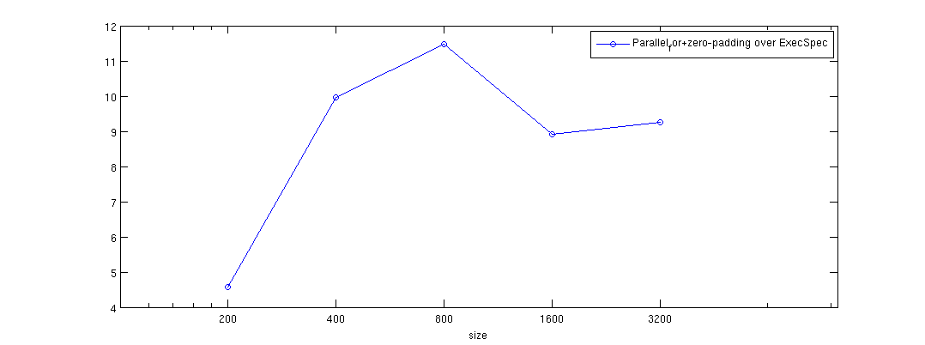
Non-Periodic heat
Performance on Cagnode9, 8 core machine,
Intel Xeon X5460@3.16GHz
Cache size: 6144 KB
GNU Linux 2.6.x, x86_64
Speedup of parallel_for + zero-padding over
raw ExecSpec

Slide 30
Can it go faster?
Pochoir<double, 2> heat;
Pochoir_Array<double, 2> a(N, M);
Pochoir_Shape<2> shape[6] = {{0, 0, 0}, {-1, 1, 0}, {-1, 0, 0}, {-1, -1, 0}, {-1, 0, -1}, {-1, 0, 1}};
Pochoir_Boundary_2D(bdry, arr, t, i, j)
if (i <= 0 || i >= arr.size(1)-1 || j < =0 || j >= arr.size(0)-1)
return 0;
else
return arr.get(t, i, j);
Pochoir_Boundary_end
Pochoir_kernel_2D(kern, t, i, j)
a(t, i, j) = 0.125 * (a(t-1, i+1, j) - 2.0 * a(t-1, i, j) + a(t-1, i-1, j)) + 0.125 * (a(t-1, i, j+1) - 2.0 * a(t-1, i, j) + a(t-1, i, j-1)) + a(t-1, i, j);1)) + a(t-1, i, j);
Pochoir_kernel_end
for (int i = 0; i < N; ++i) {
for (int j = 0; j < N; ++j) {
a(0, i, j) = rand();
}}
heat.registerBoundaryFn(a, bdry);
heat.registerShape(shape);
heat.run(T, kern);

Slide 31
Minimize the boundary checking
t
x

Slide 32
Adaptive Cutting Strategy
Minimize the boundary region
t
x

Slide 33
Macro Trick
Pochoir<double, 2> heat;
Pochoir_Array<double, 2> a(N, M);
Pochoir_Shape<2> shape[6] = {{1, 0, 0}, {0, 1, 0}, {0, -1, 0}, {0, 0, 0}, {0, 0, -1}, {0, 0, 1}}; Pochoir_Boundary_2D(bdry, arr, t, i, j)
if (i <= 0 || i >= arr.size(1)-1 || j < =0 || j >= arr.size(0)-1)
return 0;
else
return arr.get(t, i, j);
Pochoir_Boundary_end
Pochoir_kernel_2D(kern, t, i, j)
a(t, i, j) = 0.125 * (a(t-1, i+1, j) - 2.0 * a(t-1, i, j) + a(t-1, i-1, j)) + 0.125 * (a(t-1, i, j+1) - 2.0 * a(t-1, i, j) + a(t-1, i, j-1)) + a(t-1, i, j);1)) + a(t-1, i, j);
Pochoir_kernel_end
heat.registerBoundaryFn(a, bdry);
heat.registerArray(a);
heat.registerShape(shape);
heat.run(T, kern);
Pochoir<double, 2> heat;
Pochoir_Array<double, 2> a(N, M);
Pochoir_Shape<2> shape[6] = {{0, 0, 0}, {-1, 1, 0}, {-1, 0, 0}, {-1, -1, 0}, {-1, 0, -1}, {-1, 0, 1}}; Pochoir_Boundary_2D(bdry, arr, t, i, j)
if (i <= 0 || i >= arr.size(1)-1 || j < =0 || j >= arr.size(0)-1)
return 0;
else
return arr.get(t, i, j);
Pochoir_Boundary_end
Pochoir_kernel_2D(kern, t, i, j)
a(t, i, j) = 0.125 * (a(t-1, i+1, j) - 2.0 * a(t-1, i, j) + a(t-1, i-1, j)) + 0.125 * (a(t-1, i, j+1) - 2.0 * a(t-1, i, j) + a(t-1, i, j-1)) + a(t-1, i, j);1)) + a(t-1, i, j);
Pochoir_kernel_end
heat.registerBoundaryFn(a, bdry);
heat.registerShape(shape);
{
#define a(t, i, j) a.interior(t, i, j)
Pochoir_kernel_2D(interior_kern, t, i, j)
a(t, i, j) = 0.125 * (a(t-1, i+1, j) - 2.0 * a(t-1, i, j) + a(t-1, i-1, j)) + 0.125 * (a(t-1, i, j+1) - 2.0 * a(t-1, i, j) + a(t-1, i, j-1)) + a(t-1, i, j);1)) + a(t-1, i, j);
Pochoir_kernel_end
#undef a(t, i, j)
heat.run(T, interior_kern, kern);
}

Slide 34
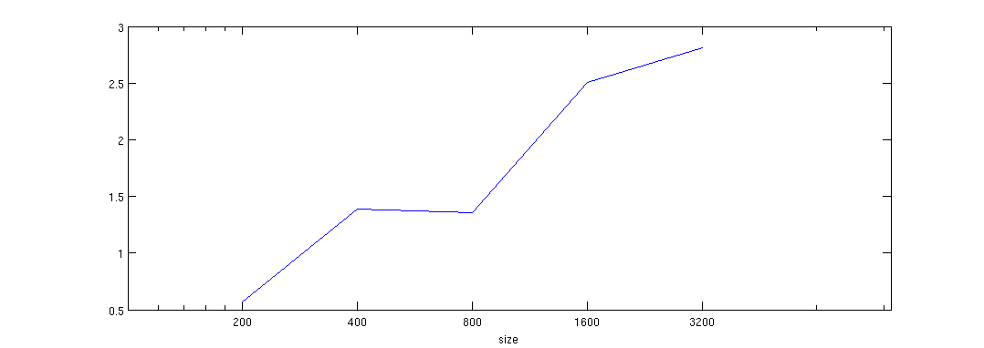
Non-Periodic heat
Performance on Cagnode9, 8 core machine,
Intel Xeon X5460@3.16GHz
Cache size: 6144 KB
GNU Linux 2.6.x, x86_64
Speedup of -split-macro-shadow over
parallel_for + zero padding

Slide 35
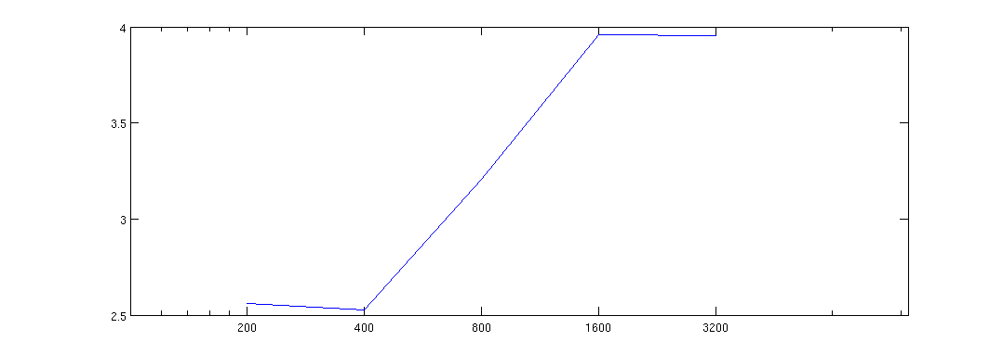
Periodic heat
Performance on Cagnode9, 8 core machine,
Intel Xeon X5460@3.16GHz
Cache size: 6144 KB
GNU Linux 2.6.x, x86_64
Speedup of -split-macro-shadow over
parallel_for

Slide 36
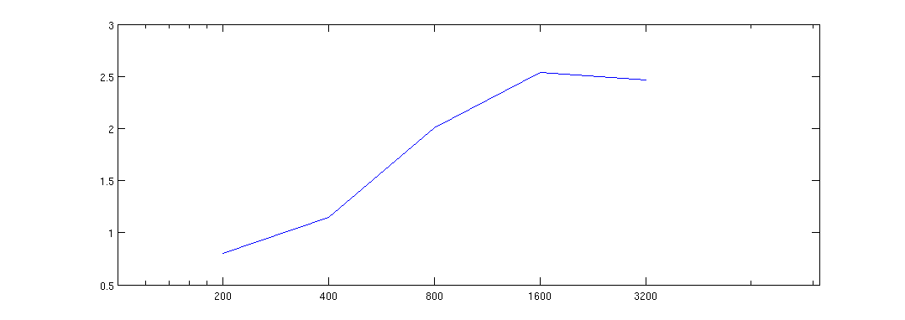
Periodic Game of Life
Performance on Cagnode9, 8 core machine,
Intel Xeon X5460@3.16GHz
Cache size: 6144 KB
GNU Linux 2.6.x, x86_64
Speedup of -split-macro-shadow over
parallel_for

Slide 37
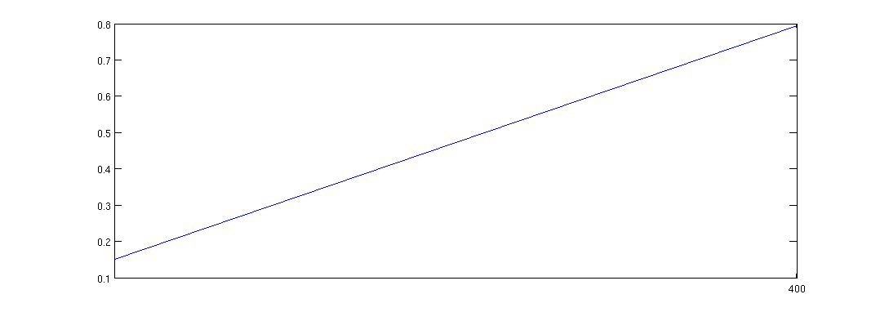
Non-Periodic 3dfd
Performance on Cagnode9, 8 core machine,
Intel Xeon X5460@3.16GHz
Cache size: 6144 KB
GNU Linux 2.6.x, x86_64
Speedup of -split-macro-shadow over
C-style pointer+parallel_for + zero padding

Slide 38
indexing issue
Pochoir<double, 2> heat;
Pochoir_Array<double, 2> a(N, M);
Pochoir_Shape<2> shape[6] = {{0, 0, 0}, {-1, 1, 0}, {-1, 0, 0}, {-1, -1, 0}, {-1, 0, -1}, {-1, 0, 1}}; Pochoir_Boundary_2D(bdry, arr, t, i, j)
if (i <= 0 || i >= arr.size(1)-1 || j < =0 || j >= arr.size(0)-1)
return 0;
else
return arr.get(t, i_dom, j);
Pochoir_Boundary_end
Pochoir_kernel_2D(kern, t, i, j)
a(t, i, j) = 0.125 * (a(t-1, i+1, j) - 2.0 * a(t-1, i, j) + a(t-1, i-1, j)) + 0.125 * (a(t-1, i, j+1) - 2.0 * a(t-1, i, j) + a(t-1, i, j-1)) + a(t-1, i, j);1)) + a(t-1, i, j);
Pochoir_kernel_end
heat.registerBoundaryFn(a, bdry);
heat.registerShape(shape);
{
#define a(t, i, j) a.interior(t, i, j)
Pochoir_kernel_2D(interior_kern, t, i, j)
a(t, i, j) = 0.125 * (a(t-1, i+1, j) - 2.0 * a(t-1, i, j) + a(t-1, i-1, j)) + 0.125 * (a(t-1, i, j+1) - 2.0 * a(t-1, i, j) + a(t-1, i, j-1)) + a(t-1, i, j);1)) + a(t-1, i, j);
Pochoir_kernel_end
#undef a(t, i, j)
heat.run(T, interior_kern, kern);
}

Slide 39
indexing issue
Pochoir<double, 2> heat;
Pochoir_Array<double, 2> a(N, M);
Pochoir_Shape<2> shape[6] = {{0, 0, 0}, {-1, 1, 0}, {-1, 0, 0}, {-1, -1, 0}, {-1, 0, -1}, {-1, 0, 1}}; Pochoir_Boundary_2D(bdry, arr, t, i, j)
if (i <= 0 || i >= arr.size(1)-1 || j < =0 || j >= arr.size(0)-1)
return 0;
else
return arr.get(t, i, j);
Pochoir_Boundary_end
Pochoir_kernel_2D(kern, t, i, j)
a(t, i, j) = 0.125 * (a(t-1, i+1, j) - 2.0 * a(t-1, i, j) + a(t-1, i-1, j)) + 0.125 * (a(t-1, i, j+1) - 2.0 * a(t-1, i, j) + a(t-1, i, j-1)) + a(t-1, i, j);1)) + a(t-1, i, j);
Pochoir_kernel_end
heat.registerBoundaryFn(a, bdry);
heat.registerShape(shape);
{
#define a(t, i, j) a.interior(t, i, j)
Pochoir_kernel_2D(interior_kern, t, i, j)
a(t, i, j) = 0.125 * (a(t-1, i+1, j) - 2.0 * a(t-1, i, j) + a(t-1, i-1, j)) + 0.125 * (a(t-1, i, j+1) - 2.0 * a(t-1, i, j) + a(t-1, i, j-1)) + a(t-1, i, j);1)) + a(t-1, i, j);
Pochoir_kernel_end
#undef a(t, i, j)
heat.run(T, interior_kern, kern);
}
for (int t = 0; t < T_SIZE; ++t) {
for (int i= 0; i < N; ++i) {
for (int j = 0; j < N; ++j) {
a[(t&1)*total_size + i * stride_i +
j*stride_j] = ….
}
}
}

Slide 40
indexing issue
Pochoir<double, 2> heat;
Pochoir_Array<double, 2> a(N, M);
Pochoir_Shape<2> shape[6] = {{0, 0, 0}, {-1, 1, 0}, {-1, 0, 0}, {-1, -1, 0}, {-1, 0, -1}, {-1, 0, 1}}; Pochoir_Boundary_2D(bdry, arr, t, i, j)
if (i <= 0 || i >= arr.size(1)-1 || j < =0 || j >= arr.size(0)-1)
return 0;
else
return arr.get(t, i, j);
Pochoir_Boundary_end
Pochoir_kernel_2D(kern, t, i, j)
a(t, i, j) = 0.125 * (a(t-1, i+1, j) - 2.0 * a(t-1, i, j) + a(t-1, i-1, j)) + 0.125 * (a(t-1, i, j+1) - 2.0 * a(t-1, i, j) + a(t-1, i, j-1)) + a(t-1, i, j);1)) + a(t-1, i, j);
Pochoir_kernel_end
heat.registerBoundaryFn(a, bdry);
heat.registerShape(shape);
{
#define a(t, i, j) a.interior(t, i, j)
Pochoir_kernel_2D(interior_kern, t, i, j)
a(t, i, j) = 0.125 * (a(t-1, i+1, j) - 2.0 * a(t-1, i, j) + a(t-1, i-1, j)) + 0.125 * (a(t-1, i, j+1) - 2.0 * a(t-1, i, j) + a(t-1, i, j-1)) + a(t-1, i, j);1)) + a(t-1, i, j);
Pochoir_kernel_end
#undef a(t, i, j)
heat.run(T, interior_kern, kern);
}
for (int t = 0; t < T_SIZE; ++t) {
for (int i = 0; i < N; ++i) {
for (int j = 0; j < N; ++j) {
a[(t&1)*total_size + i * stride_i +
j*stride_j] = ….
}
}
}
for (int t = 0; t < T_SIZE; ++t) {
_t = (t&1) * total_size;
for (int i = 0; i < N; ++i) {
_i = i * stride_i;
for (int j = 0; j < N; ++j) {
_j = j * stride_j;
a[_t + _i + _j] = ….
}
}
}

Slide 41
Using Iterator to traverse internal sub-trapezoid
t
x

Slide 42
Base case optimized by iterator
Pochoir<double, 2> heat;
Pochoir_Array<double, 2> a(N, M);
Pochoir_Shape<2> shape[6] = {{0, 0, 0}, {-1, 1, 0}, {-1, 0, 0}, {-1, -1, 0}, {-1, 0, -1}, {-1, 0, 1}}; Pochoir_Boundary_2D(bdry, arr, t, i, j)
if (i <= 0 || i >= arr.size(1)-1 || j < =0 || j >= arr.size(0)-1)
return 0;
else
return arr.get(t, i, j);
Pochoir_Boundary_end
Pochoir_kernel_2D(kern, t, i, j)
a(t, i, j) = 0.125 * (a(t-1, i+1, j) - 2.0 * a(t-1, i, j) + a(t-1, i-1, j)) + 0.125 * (a(t-1, i, j+1) - 2.0 * a(t-1, i, j) + a(t-1, i, j-1)) + a(t-1, i, j);1)) + a(t-1, i, j);
Pochoir_kernel_end
heat.registerBoundaryFn(a, bdry);
heat.registerShape(shape);
{
#define a(t, i, j) a.interior(t, i, j)
Pochoir_kernel_2D(interior_kern, t, i, j)
a(t, i, j) = 0.125 * (a(t-1, i+1, j) - 2.0 * a(t-1, i, j) + a(t-1, i-1, j)) + 0.125 * (a(t-1, i, j+1) - 2.0 * a(t-1, i, j) + a(t-1, i, j-1)) + a(t-1, i, j);1)) + a(t-1, i, j);
Pochoir_kernel_end
#undef a(t, i, j)
heat.run(T, interior_kern, kern);
}
Pochoir_kernel_2D(iter_kern, t, i_dom, j)
grid_info<2> l_grid = grid;
Pochoir_Iterator<double, 2> iter0(a); Pochoir_Iterator<double, 2> iter1(a);
Pochoir_Iterator<double, 2> iter2(a); Pochoir_Iterator<double, 2> iter3(a);
Pochoir_Iterator<double, 2> iter4(a); Pochoir_Iterator<double, 2> iter5(a);
int gap_a_1, gap_a_0;
const int l_stride_a_1 = a.stride(1), l_stride_a_0 = a.stride(0);
for (int t = t0; t < t1; ++t) {
iter0.set(t + 1, l_grid.x0[1], l_grid.x0[0]);
iter1.set(t, l_grid.x0[1] + 1, l_grid.x0[0]);
iter2.set(t, l_grid.x0[1], l_grid.x0[0]);
iter3.set(t, l_grid.x0[1] - 1, l_grid.x0[0]);
iter4.set(t, l_grid.x0[1], l_grid.x0[0] + 1);
iter5.set(t, l_grid.x0[1], l_grid.x0[0] - 1);
gap_a_1 = l_stride_a_1 + (l_grid.x0[0] - l_grid.x1[0]) * l_stride_a_0;
for (int i = l_grid.x0[1]; i < l_grid.x1[1]; ++i, iter0.inc(gap_a_1), iter1.inc(gap_a_1), iter2.inc(gap_a_1), iter3.inc(gap_a_1), iter4.inc(gap_a_1), iter5.inc(gap_a_1)) {
for (int j = l_grid.x0[0]; j < l_grid.x1[0]; ++j, ++iter0, ++iter1, ++iter2, ++iter3, ++iter4, ++iter5) {
iter0 = 0.125 * (iter1 - 2.0 * iter2 + iter3) + 0.125 * (iter4 - 2.0 * iter2 + iter5) + iter2;
} } /* end for (sub-trapezoid) */
/* Adjust sub-trapezoid! */
for (int i = 0; i < 2; ++i) {
l_grid.x0[i] += l_grid.dx0[i]; l_grid.x1[i] += l_grid.dx1[i];
}
} /* end for t */
Pochoir_kernel_end
heat.run_obase(T_SIZE, obase_kern, kern);
}
One iterator for one shape item

Slide 43
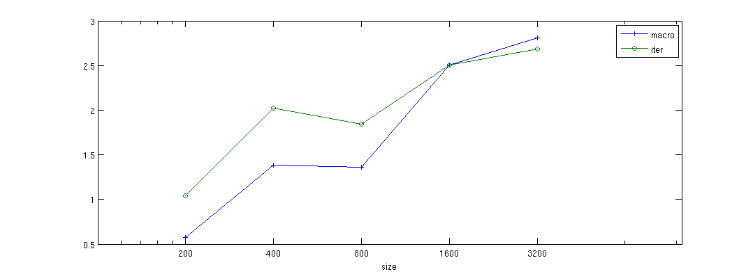
Non-Periodic heat
Performance on Cagnode9, 8 core machine,
Intel Xeon X5460@3.16GHz
Cache size: 6144 KB
GNU Linux 2.6.x, x86_64
Speedup of -split-iter over parallel_for
, –split-macro-shadow over parallel_for

Slide 44
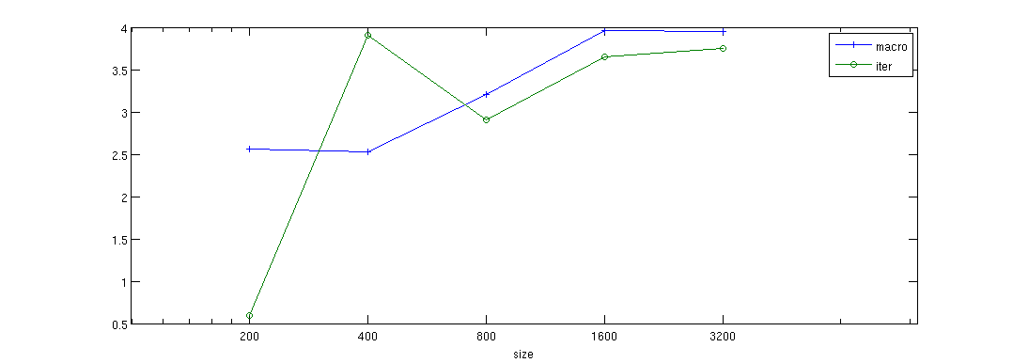
Periodic heat
Performance on Cagnode9, 8 core machine,
Intel Xeon X5460@3.16GHz
Cache size: 6144 KB
GNU Linux 2.6.x, x86_64
Speedup of -split-iter over parallel_for
, speedup of –split-macro-shadow over
parallel_for

Slide 45
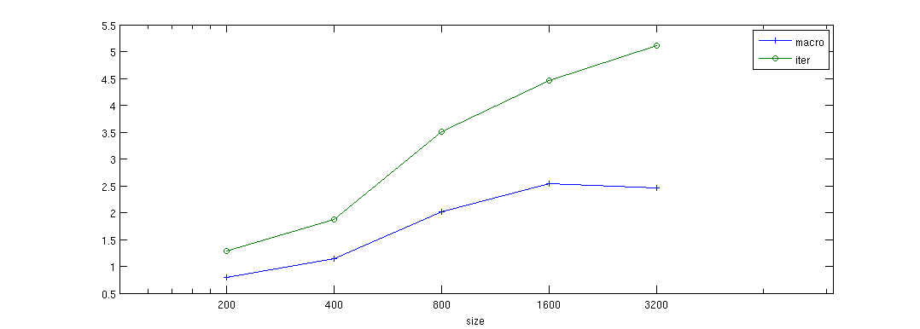
Periodic Game of Life
Performance on Cagnode9, 8 core machine,
Intel Xeon X5460@3.16GHz
Cache size: 6144 KB
GNU Linux 2.6.x, x86_64
Speedup of –split-iter over parallel_for
, speedup of –split-macro-shadow over
Parallel_for

Slide 46
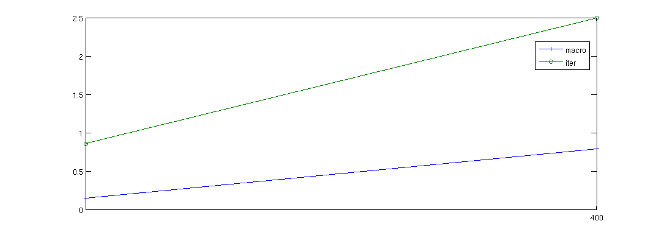
Non-Periodic 3dfd
Performance on Cagnode9, 8 core machine,
Intel Xeon X5460@3.16GHz
Cache size: 6144 KB
GNU Linux 2.6.x, x86_64
Speedup of -split-iter over parallel_for
, speedup of –split-macro-shadow over
parallel_for

Slide 47
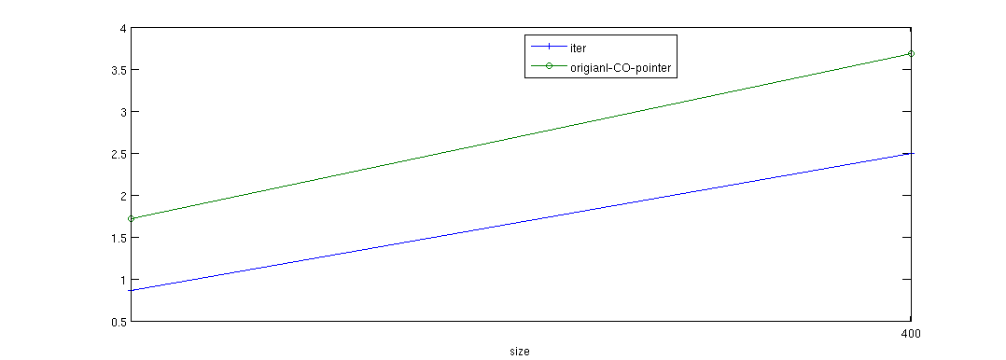
Performance bug revealed by 3dfd
Performance on Cagnode9, 8 core machine,
Intel Xeon X5460@3.16GHz
Cache size: 6144 KB
GNU Linux 2.6.x, x86_64
Speedup of -split-iter over parallel_for
versus original CO in 3dfd (C-style pointer)

Slide 48
problems in iterator
Pochoir<double, 2> heat;
Pochoir_Array<double, 2> a(N, M);
Pochoir_Shape<2> shape[6] = {{1, 0, 0}, {0, 1, 0}, {0, -1, 0}, {0, 0, -1}, {0, 0, 1}};
Pochoir_Boundary_2D(bdry, arr, t, i, j)
if (i <= 0 || i >= arr.size(1)-1 || j < =0 || j >= arr.size(0)-1)
return 0;
else
return arr.get(t, i, j);
Pochoir_Boundary_end
Pochoir_kernel_2D(kern, t, i, j)
a(t, i, j) = 0.125 * (a(t-1, i+1, j) - 2.0 * a(t-1, i, j) + a(t-1, i-1, j)) + 0.125 * (a(t-1, i, j+1) - 2.0 * a(t-1, i, j) + a(t-1, i, j-1)) + a(t-1, i, j);1)) + a(t-1, i, j);
Pochoir_kernel_end
heat.registerBoundaryFn(a, bdry);
heat.registerShape(shape);
heat.run(T, kern);
Pochoir_kernel_2D(iter_kern, t, i_dom, j)
grid_info<2> l_grid = grid;
Pochoir_Iterator<double, 2> iter0(a); Pochoir_Iterator<double, 2> iter1(a);
Pochoir_Iterator<double, 2> iter2(a); Pochoir_Iterator<double, 2> iter3(a);
Pochoir_Iterator<double, 2> iter4(a); Pochoir_Iterator<double, 2> iter5(a);
int gap_a_1, gap_a_0;
const int l_stride_a_1 = a.stride(1), l_stride_a_0 = a.stride(0);
for (int t = t0; t < t1; ++t) {
iter0.set(t + 1, l_grid.x0[1], l_grid.x0[0]);
iter1.set(t, l_grid.x0[1] + 1, l_grid.x0[0]);
iter2.set(t, l_grid.x0[1], l_grid.x0[0]);
iter3.set(t, l_grid.x0[1] - 1, l_grid.x0[0]);
iter4.set(t, l_grid.x0[1], l_grid.x0[0] + 1);
iter5.set(t, l_grid.x0[1], l_grid.x0[0] - 1);
gap_a_1 = l_stride_a_1 + (l_grid.x0[0] - l_grid.x1[0]) * l_stride_a_0;
for (int i = l_grid.x0[1]; i < l_grid.x1[1]; ++i, iter0.inc(gap_a_1), iter1.inc(gap_a_1), iter2.inc(gap_a_1), iter3.inc(gap_a_1), iter4.inc(gap_a_1), iter5.inc(gap_a_1)) {
for (int j = l_grid.x0[0]; j < l_grid.x1[0]; ++j, ++iter0, ++iter1, ++iter2, ++iter3, ++iter4, ++iter5) {
iter0 = 0.125 * (iter1 - 2.0 * iter2 + iter3) + 0.125 * (iter4 - 2.0 * iter2 + iter5) + iter2;
} } /* end for (sub-trapezoid) */
/* Adjust sub-trapezoid! */
for (int i = 0; i < 2; ++i) {
l_grid.x0[i] += l_grid.dx0[i]; l_grid.x1[i] += l_grid.dx1[i];
}
} /* end for t */
Pochoir_kernel_end
heat.run_obase(T_SIZE, obase_kern, kern);
}

Slide 49
From iterator to pointer
Pochoir_kernel_2D(iter_kern, t, i_dom, j)
grid_info<2> l_grid = grid;
Pochoir_Iterator<double, 2> iter0(a); Pochoir_Iterator<double, 2> iter1(a);
Pochoir_Iterator<double, 2> iter2(a); Pochoir_Iterator<double, 2> iter3(a);
Pochoir_Iterator<double, 2> iter4(a); Pochoir_Iterator<double, 2> iter5(a);
int gap_a_1, gap_a_0;
const int l_stride_a_1 = a.stride(1), l_stride_a_0 = a.stride(0);
for (int t = t0; t < t1; ++t) {
iter0.set(t + 1, l_grid.x0[1], l_grid.x0[0]);
iter1.set(t, l_grid.x0[1] + 1, l_grid.x0[0]);
iter2.set(t, l_grid.x0[1], l_grid.x0[0]);
iter3.set(t, l_grid.x0[1] - 1, l_grid.x0[0]);
iter4.set(t, l_grid.x0[1], l_grid.x0[0] + 1);
iter5.set(t, l_grid.x0[1], l_grid.x0[0] - 1);
gap_a_1 = l_stride_a_1 + (l_grid.x0[0] - l_grid.x1[0]) * l_stride_a_0;
for (int i = l_grid.x0[1]; i < l_grid.x1[1]; ++i, iter0.inc(gap_a_1), iter1.inc(gap_a_1), iter2.inc(gap_a_1), iter3.inc(gap_a_1), iter4.inc(gap_a_1), iter5.inc(gap_a_1)) {
for (int j = l_grid.x0[0]; j < l_grid.x1[0]; ++j, ++iter0, ++iter1, ++iter2, ++iter3, ++iter4, ++iter5) {
iter0 = 0.125 * (iter1 - 2.0 * iter2 + iter3) + 0.125 * (iter4 - 2.0 * iter2 + iter5) + iter2;
} } /* end for (sub-trapezoid) */
/* Adjust sub-trapezoid! */
for (int i = 0; i < 2; ++i) {
l_grid.x0[i] += l_grid.dx0[i]; l_grid.x1[i] += l_grid.dx1[i];
}
} /* end for t */
Pochoir_kernel_end
heat.run_obase(T_SIZE, obase_kern, kern);
}
Pochoir_kernel_2D(pointer_kern, t, i_dom, j)
grid_info<2> l_grid = grid;
double * pt_a_1; double * pt_a_0;
double * a_base = a.data();
const int l_a_total_size = a.total_size();
int gap_a_1, gap_a_0;
const int l_stride_a_1 = a.stride(1), l_stride_a_0 = a.stride(0);
for (int t = t0; t < t1; ++t) {
pt_a_0 = a_base + ((t + 1) & 1) * l_a_total_size + l_grid.x0[1] * l_stride_a_1 + l_grid.x0[0] * l_stride_a_0;
pt_a_1 = a_base + ((t) & 1) * l_a_total_size + l_grid.x0[1] * l_stride_a_1 + l_grid.x0[0] * l_stride_a_0;
gap_a_1 = l_stride_a_1 + (l_grid.x0[0] - l_grid.x1[0]) * l_stride_a_0;
for (int i = l_grid.x0[1]; i < l_grid.x1[1]; ++i, pt_a_0 += gap_a_1, pt_a_1 += gap_a_1) {
#pragma ivdep
for (int j = l_grid.x0[0]; j < l_grid.x1[0]; ++j, ++pt_a_0, ++pt_a_1) {
pt_a_0[0] = 0.125 * (pt_a_1[l_stride_a_1 * (1)] - 2.0 * pt_a_1[0] + pt_a_1[l_stride_a_1 * (-1)]) + 0.125 * (pt_a_1[l_stride_a_0 * (1)] - 2.0 * pt_a_1[0] + pt_a_1[l_stride_a_0 * (-1)]) + pt_a_1[0];
} } /* end for (sub-trapezoid) */
/* Adjust sub-trapezoid! */
for (int i = 0; i < 2; ++i) {
l_grid.x0[i] += l_grid.dx0[i]; l_grid.x1[i] += l_grid.dx1[i];
}
} /* end for t */
Pochoir_kernel_end
heat.run_obase(T_SIZE, pointer_kern, kern);
}

Slide 50
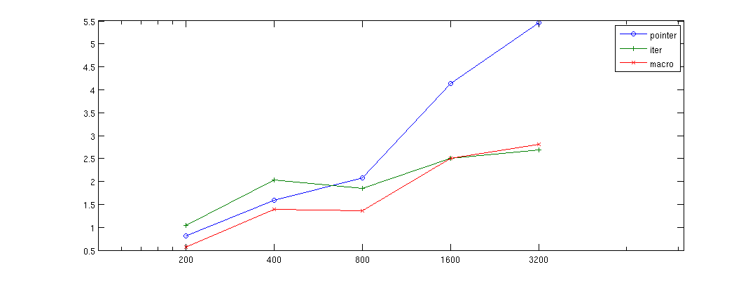
Non-Periodic heat
Performance on Cagnode9, 8 core machine,
Intel Xeon X5460@3.16GHz
Cache size: 6144 KB
GNU Linux 2.6.x, x86_64
Speedup of -split-pointer over parallel_for
-split-iter over parallel_for
-split-macro-shadow over parallel_for

Slide 51
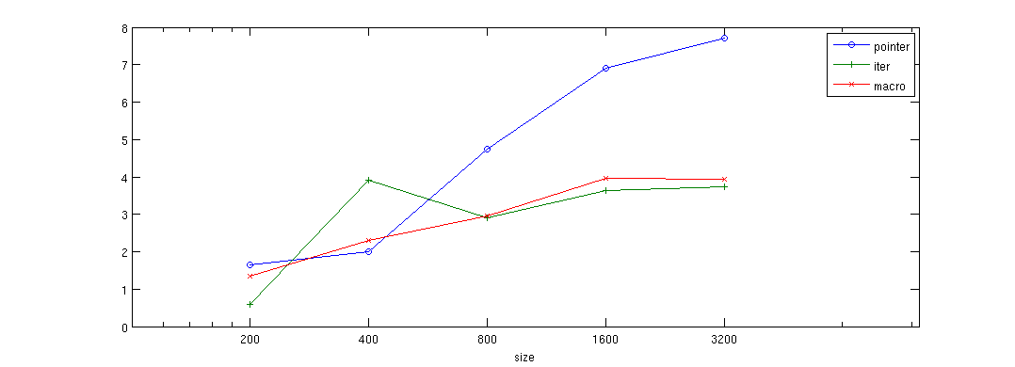
Periodic heat
Performance on Cagnode9, 8 core machine,
Intel Xeon X5460@3.16GHz
Cache size: 6144 KB
GNU Linux 2.6.x, x86_64
Speedup of -split-pointer over parallel_for
-split-iter over parallel_for
-split-macro-shadow over parallel_for

Slide 52
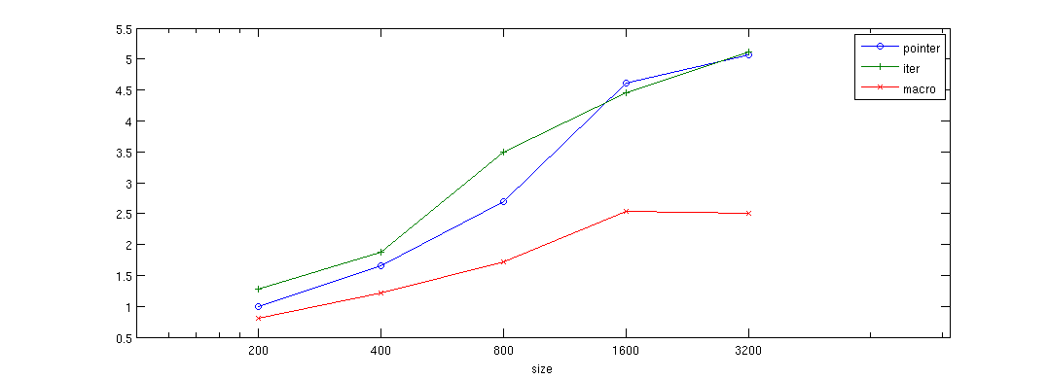
Periodic Game of Life
Performance on Cagnode9, 8 core machine,
Intel Xeon X5460@3.16GHz
Cache size: 6144 KB
GNU Linux 2.6.x, x86_64
Speedup of -split-pointer over parallel_for
-split-iter over parallel_for
-split-macro-shadow over parallel_for

Slide 53
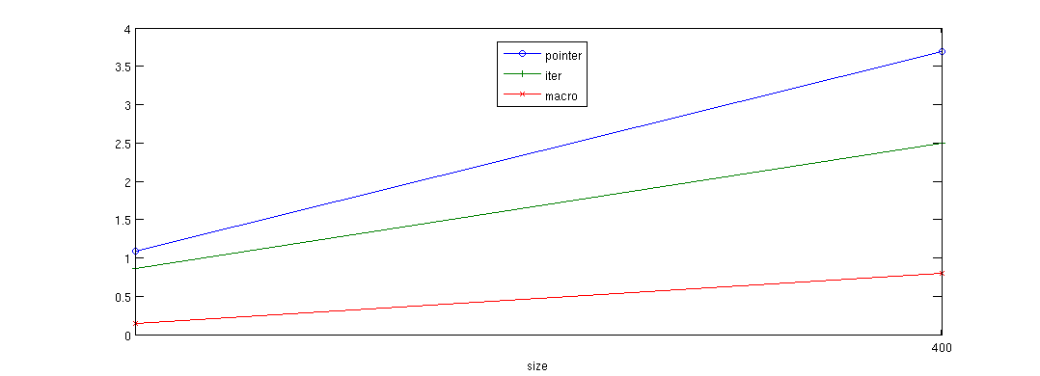
Non-Periodic 3dfd
Performance on Cagnode9, 8 core machine,
Intel Xeon X5460@3.16GHz
Cache size: 6144 KB
GNU Linux 2.6.x, x86_64
Speedup of -split-pointer over parallel_for
-split-iter over parallel_for
-split-macro-shadow over parallel_for

Slide 54
Conclusion
Executable Spec. version 1.0 ready to go
P = NP
Different optimization level shows up very different performance behavior
Cache oblivious algorithm is really cache insensitive and loop-based (serial version) is very cache sensitive
Boundary checking and handling is still a significant overhead although minimized.

Slide 55
Known Problem
In Pochoir, we specify boundary condition by an arbitrary C++ function
Pros: Flexible, Unifying the P and NP
Cons: Too much power
e.g. wire up edge directly to the middle
Type theory comes to the rescue
For a given type, only such set of operations are allowed, otherwise, a compile-time error
Proposed solution:
Make the indices variable of a new type ‘dim’ in boundary function
Restrict the way that user can manipulate the indices of Pochoir_Array
Only certain operations are allowed on type ‘dim’.
Avoid arbitrary manipulation of indices and Pochoir_Array inside boundary function
Notes:
Potential operations on Dim variable
Non-Periodic: return value, return func /* assuming func is NOT an alias of any Pochoir_Array */
Periodic: normal modulo operation, change_direction /* array_size – i */.
Switch some dim variables, such as arr.get(j, i);

Slide 56
Potential (Allowable) operations on type ‘dim’
Non-Periodic Stencil
return value
return func /* assuming func is NOT an alias of any Pochoir_Array */
Periodic Stencil
Normal modulo operation
change_direction /* array_size – i */
Abnormal Stencil
Switch some dim variables
e.g. arr.get(j, i)
Notes:
Potential operations on Dim variable
Non-Periodic: return value, return func /* assuming func is NOT an alias of any Pochoir_Array */
Periodic: normal modulo operation, change_direction /* array_size – i */.
Switch some dim variables, such as arr.get(j, i);

Slide 57

Example boundaries - cyclinder
Notes:
Potential operations on Dim variable
Non-Periodic: return value, return func /* assuming func is NOT an alias of any Pochoir_Array */
Periodic: normal modulo operation, change_direction /* array_size – i */.
Switch some dim variables, such as arr.get(j, i);

Slide 58
Example boundaries - cylinder
Pochoir_Boundary_2D(bdry, arr, t, i, j)
dim<1> new_i = i;
dim<0> new_j = j;
/* dim 1 is non-periodic */
if (! pochoir_inside_domain(new_i, arr))
return 0;
/* dim 0 is periodic */
new_j = pochoir_mod(arr, new_j);
return arr.get(t, new_i, new_j);
Pochoir_Boundary_end
Notes:
Potential operations on Dim variable
Non-Periodic: return value, return func /* assuming func is NOT an alias of any Pochoir_Array */
Periodic: normal modulo operation, change_direction /* array_size – i */.
Switch some dim variables, such as arr.get(j, i);

Slide 59
Example boundaries - cylinder
Pochoir_Boundary_2D(bdry, arr, t, i, j)
dim<1> new_i = i;
dim<0> new_j = j;
/* dim 1 is non-periodic */
if (! pochoir_inside_domain(new_i, arr))
return 0;
/* dim 0 is periodic */
new_j = pochoir_mod(arr, new_j);
return arr.get(t, new_i, new_j);
Pochoir_Boundary_end
Declare two variables of type dim<rank>
rank is the rank of spatial dimension
Notes:
Potential operations on Dim variable
Non-Periodic: return value, return func /* assuming func is NOT an alias of any Pochoir_Array */
Periodic: normal modulo operation, change_direction /* array_size – i */.
Switch some dim variables, such as arr.get(j, i);

Slide 60
Example boundaries - cylinder
Pochoir_Boundary_2D(bdry, arr, t, i, j)
dim<1> new_i = i;
dim<0> new_j = j;
/* dim 1 is non-periodic */
if (! pochoir_inside_domain(new_i, arr))
return 0;
/* dim 0 is periodic */
new_j = pochoir_mod(arr, new_j);
return arr.get(t, new_i, new_j);
Pochoir_Boundary_end
dim<1>: new_i is non-periodic;
Notes:
Potential operations on Dim variable
Non-Periodic: return value, return func /* assuming func is NOT an alias of any Pochoir_Array */
Periodic: normal modulo operation, change_direction /* array_size – i */.
Switch some dim variables, such as arr.get(j, i);

Slide 61
Example boundaries - cylinder
Pochoir_Boundary_2D(bdry, arr, t, i, j)
dim<1> new_i = i;
dim<0> new_j = j;
/* dim 1 is non-periodic */
if (! pochoir_inside_domain(new_i, arr))
return 0;
/* dim 0 is periodic */
new_j = pochoir_mod(arr, new_j);
return arr.get(t, new_i, new_j);
Pochoir_Boundary_end
dim<0>: new_j is non-periodic;
Notes:
Potential operations on Dim variable
Non-Periodic: return value, return func /* assuming func is NOT an alias of any Pochoir_Array */
Periodic: normal modulo operation, change_direction /* array_size – i */.
Switch some dim variables, such as arr.get(j, i);

Slide 62
Example boundaries - cylinder
Pochoir_Boundary_2D(bdry, arr, t, i, j)
dim<1> new_i = i;
dim<0> new_j = j;
/* dim 1 is non-periodic */
if (! pochoir_inside_domain(new_i, arr))
return 0;
/* dim 0 is periodic */
new_j = pochoir_mod(arr, new_j);
return arr.get(t, new_i, new_j);
Pochoir_Boundary_end
return the value at new location
(t, new_i, new_j)
Notes:
Potential operations on Dim variable
Non-Periodic: return value, return func /* assuming func is NOT an alias of any Pochoir_Array */
Periodic: normal modulo operation, change_direction /* array_size – i */.
Switch some dim variables, such as arr.get(j, i);

Slide 63
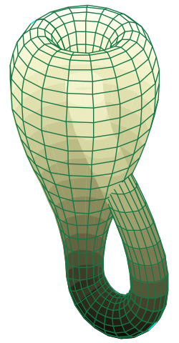
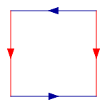
Example boundaries – Klein Bottle
Notes:
Potential operations on Dim variable
Non-Periodic: return value, return func /* assuming func is NOT an alias of any Pochoir_Array */
Periodic: normal modulo operation, change_direction /* array_size – i */.
Switch some dim variables, such as arr.get(j, i);

Slide 64
Example boundaries – Klein Bottle
Pochoir_Boundary_2D(bdry, arr, t, i, j)
dim<1> new_i = i;
dim<0> new_j = j;
new_i = pochoir_mod(arr, new_i);
if (!pochoir_inside_domain(new_j, arr) {
new_j = pochoir_mod(arr, new_j);
new_i = pochoir_change_direction(new_i);
}
return arr.get(t, new_i, new_j);
Pochoir_Boundary_end
Notes:
Potential operations on Dim variable
Non-Periodic: return value, return func /* assuming func is NOT an alias of any Pochoir_Array */
Periodic: normal modulo operation, change_direction /* array_size – i */.
Switch some dim variables, such as arr.get(j, i);

Slide 65
Example boundaries – Klein Bottle
Pochoir_Boundary_2D(bdry, arr, t, i, j)
dim<1> new_i = i;
dim<0> new_j = j;
new_i = pochoir_mod(arr, new_i);
if (!pochoir_inside_domain(new_j, arr) {
new_j = pochoir_mod(arr, new_j);
new_i = pochoir_change_direction(new_i);
}
return arr.get(t, new_i, new_j);
Pochoir_Boundary_end
Declare two variables of type dim<rank>
rank is the rank of spatial dimension
Notes:
Potential operations on Dim variable
Non-Periodic: return value, return func /* assuming func is NOT an alias of any Pochoir_Array */
Periodic: normal modulo operation, change_direction /* array_size – i */.
Switch some dim variables, such as arr.get(j, i);

Slide 66
Example boundaries – Klein Bottle
Pochoir_Boundary_2D(bdry, arr, t, i, j)
dim<1> new_i = i;
dim<0> new_j = j;
new_i = pochoir_mod(arr, new_i);
if (!pochoir_inside_domain(new_j, arr) {
new_j = pochoir_mod(arr, new_j);
new_i = pochoir_change_direction(new_i);
}
return arr.get(t, new_i, new_j);
Pochoir_Boundary_end
dim<1>: new_i is periodic;
Notes:
Potential operations on Dim variable
Non-Periodic: return value, return func /* assuming func is NOT an alias of any Pochoir_Array */
Periodic: normal modulo operation, change_direction /* array_size – i */.
Switch some dim variables, such as arr.get(j, i);

Slide 67
Example boundaries – Klein Bottle
Pochoir_Boundary_2D(bdry, arr, t, i, j)
dim<1> new_i = i;
dim<0> new_j = j;
new_i = pochoir_mod(arr, new_i);
if (!pochoir_inside_domain(new_j, arr) {
new_j = pochoir_mod(arr, new_j);
new_i = pochoir_change_direction(new_i);
}
return arr.get(t, new_i, new_j);
Pochoir_Boundary_end
dim<0>: new_j is reverse-periodic;
Notes:
Potential operations on Dim variable
Non-Periodic: return value, return func /* assuming func is NOT an alias of any Pochoir_Array */
Periodic: normal modulo operation, change_direction /* array_size – i */.
Switch some dim variables, such as arr.get(j, i);

Slide 68
Example boundaries – Klein Bottle
Pochoir_Boundary_2D(bdry, arr, t, i, j)
dim<1> new_i = i;
dim<0> new_j = j;
new_i = pochoir_mod(arr, new_i);
if (!pochoir_inside_domain(new_j, arr) {
new_j = pochoir_mod(arr, new_j);
new_i = pochoir_change_direction(new_i);
}
return arr.get(t, new_i, new_j);
Pochoir_Boundary_end
return the value at new location
(t, new_i, new_j)
Notes:
Potential operations on Dim variable
Non-Periodic: return value, return func /* assuming func is NOT an alias of any Pochoir_Array */
Periodic: normal modulo operation, change_direction /* array_size – i */.
Switch some dim variables, such as arr.get(j, i);

Slide 69
More performance numbers

Slide 70
Non-Periodic heat
Performance on Cagnode9, 8 core machine,
Intel Xeon X5460@3.16GHz
Cache size: 6144 KB
GNU Linux 2.6.x, x86_64

Slide 71
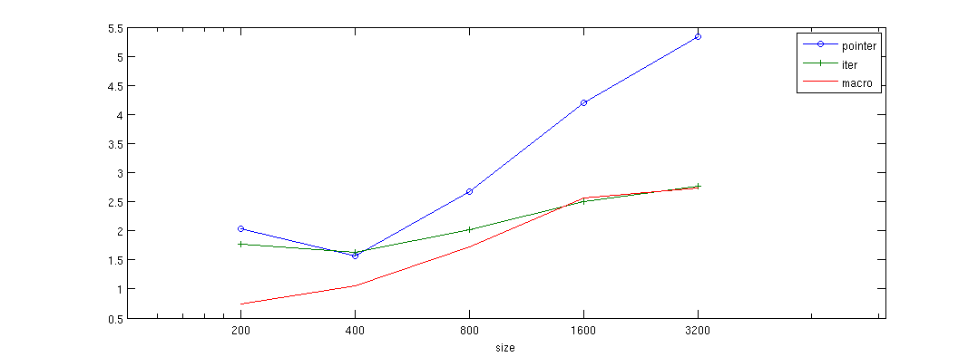
Non-Periodic heat
Performance on Cagnode17, 16 core machine,
Intel Xeon E7340@2.40GHz
Cache size: 4096 KB
GNU Linux 2.6.x, x86_64

Slide 72
Periodic heat
Performance on Cagnode9, 8 core machine,
Intel Xeon X5460@3.16GHz
Cache size: 6144 KB
GNU Linux 2.6.x, x86_64

Slide 73
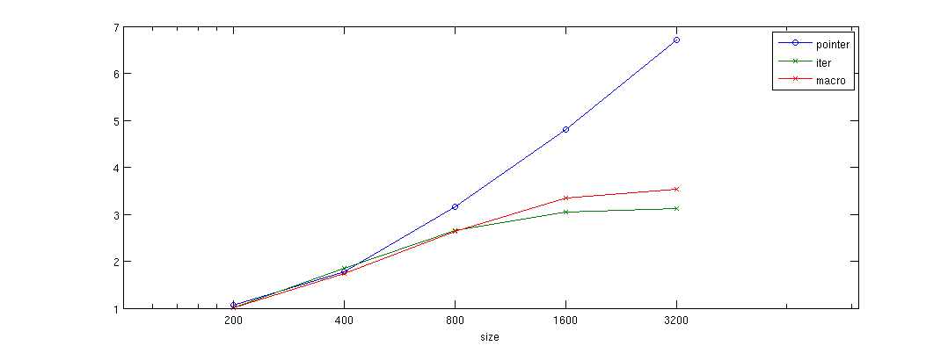
Periodic heat
Performance on Cagnode17, 16 core machine,
Intel Xeon E7340@2.40GHz
Cache size: 4096 KB
GNU Linux 2.6.x, x86_64

Slide 74
Periodic Game of Life
Performance on Cagnode9, 8 core machine,
Intel Xeon X5460@3.16GHz
Cache size: 6144 KB
GNU Linux 2.6.x, x86_64

Slide 75
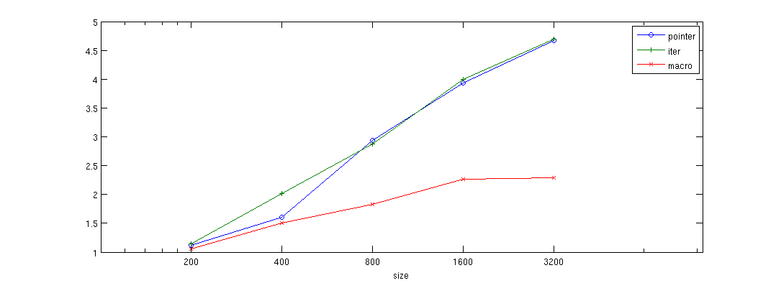
Periodic Game of Life
Performance on Cagnode17, 16 core machine,
Intel Xeon E7340@2.40GHz
Cache size: 4096 KB
GNU Linux 2.6.x, x86_64

Slide 76
Non-Periodic 3dfd
Performance on Cagnode9, 8 core machine,
Intel Xeon X5460@3.16GHz
Cache size: 6144 KB
GNU Linux 2.6.x, x86_64

Slide 77
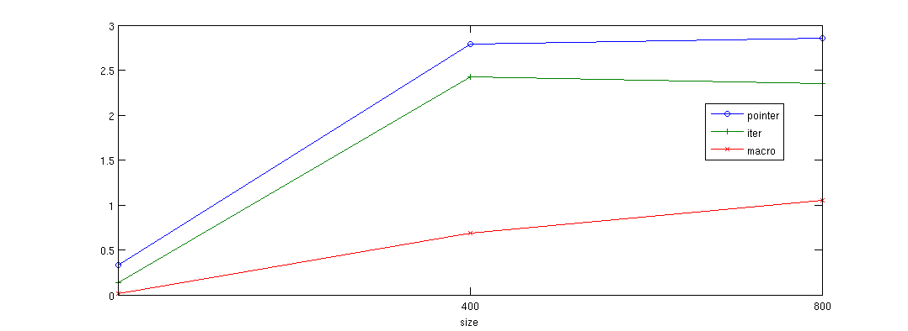
Non-Periodic 3dfd
Performance on Cagnode17, 16 core machine,
Intel Xeon E7340@2.40GHz
Cache size: 4096 KB
GNU Linux 2.6.x, x86_64

Slide 78
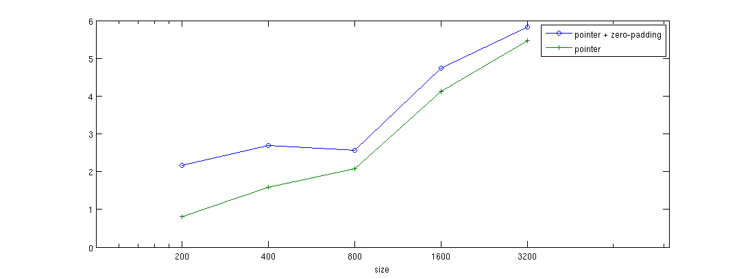
Non-Periodic heat
Performance on Cagnode9, 8 core machine,
Intel Xeon X5460@3.16GHz
Cache size: 6144 KB
GNU Linux 2.6.x, x86_64

Slide 79
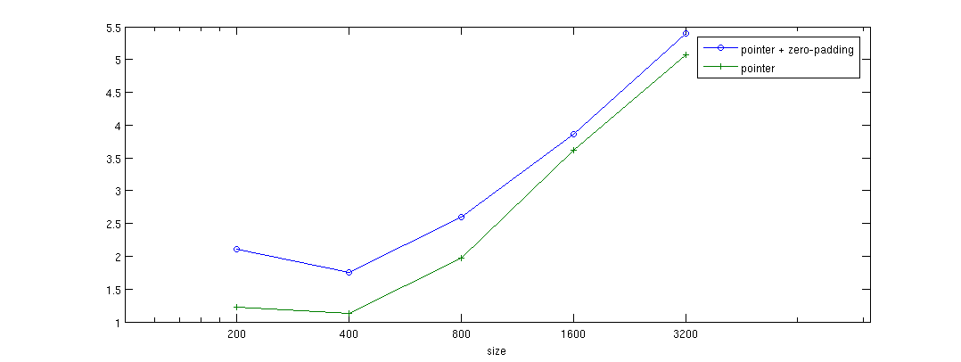
Non-Periodic heat
Performance on Cagnode17, 16 core machine,
Intel Xeon E7340@2.40GHz
Cache size: 4096 KB
GNU Linux 2.6.x, x86_64

Slide 80
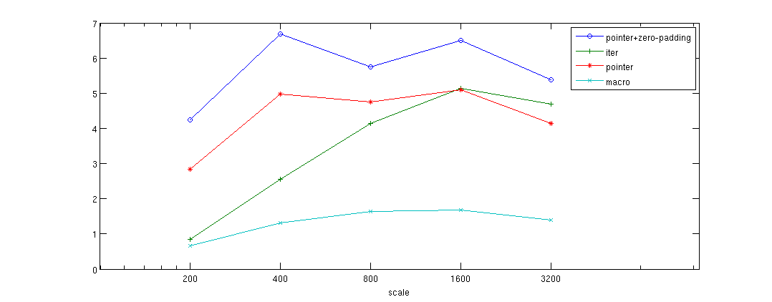
Non-Periodic heat
Performance on Octave, 6 core machine,
Intel Core i7 CPU X980@3.33GHz
Cache size: 12288 KB
GNU Linux 2.6.x, x86_64

Slide 81
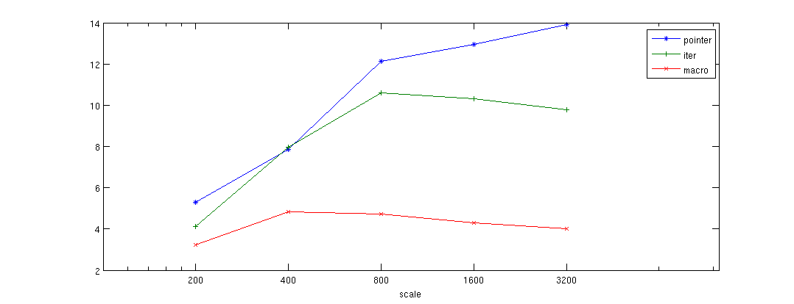
Periodic heat
Performance on Octave, 6 core machine,
Intel Core i7 CPU X980@3.33GHz
Cache size: 12288 KB
GNU Linux 2.6.x, x86_64

Slide 82
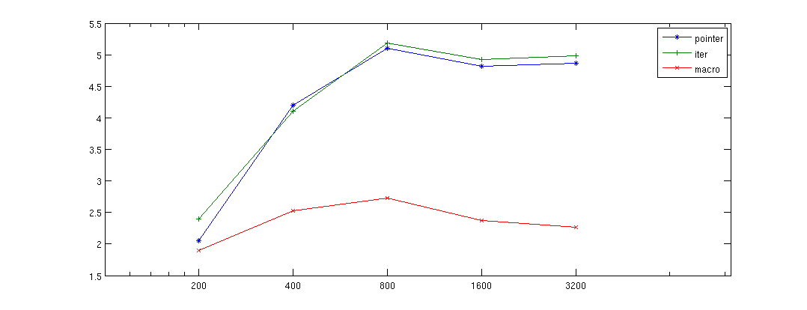
Periodic Game of Life
Performance on Octave, 6 core machine,
Intel Core i7 CPU X980@3.33GHz
Cache size: 12288 KB
GNU Linux 2.6.x, x86_64

Slide 83
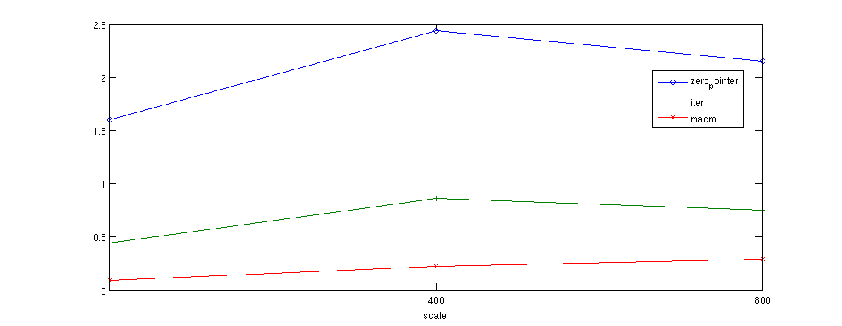
Non-Periodic 3dfd
Performance on Octave, 6 core machine,
Intel Core i7 CPU X980@3.33GHz
Cache size: 12288 KB
GNU Linux 2.6.x, x86_64

Slide 84
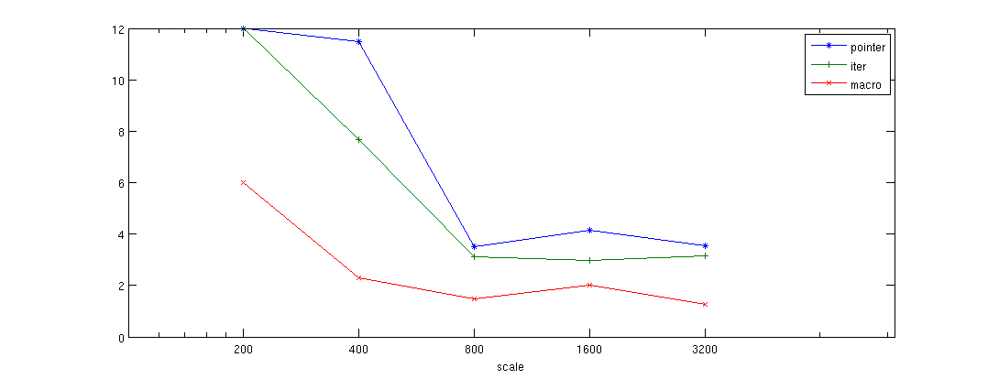
PSA
Performance on Octave, 6 core machine,
Intel Core i7 CPU X980@3.33GHz
Cache size: 12288 KB
GNU Linux 2.6.x, x86_64

Slide 85
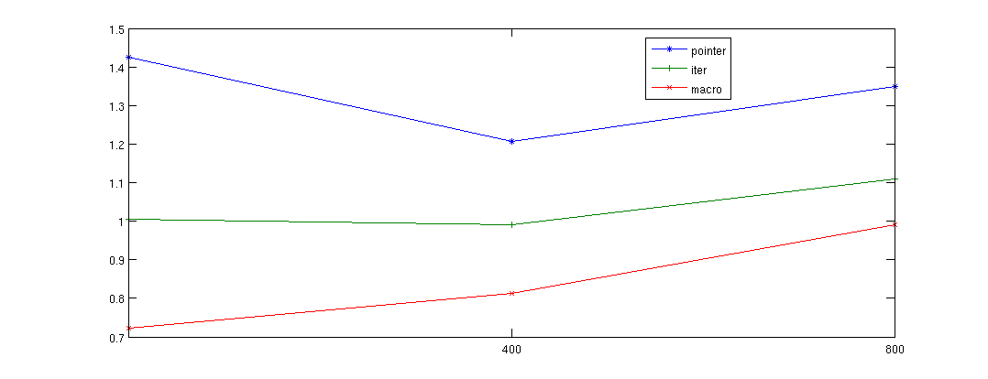
RNA
Performance on Octave, 6 core machine,
Intel Core i7 CPU X980@3.33GHz
Cache size: 12288 KB
GNU Linux 2.6.x, x86_64

